Slide 1
Bike Learning program for 4-12 years Kid

Slide 2
What is the purpose of this program to;
Young Kids?
Teachers?
Parents?
Student
Teacher
Parent

Slide 3
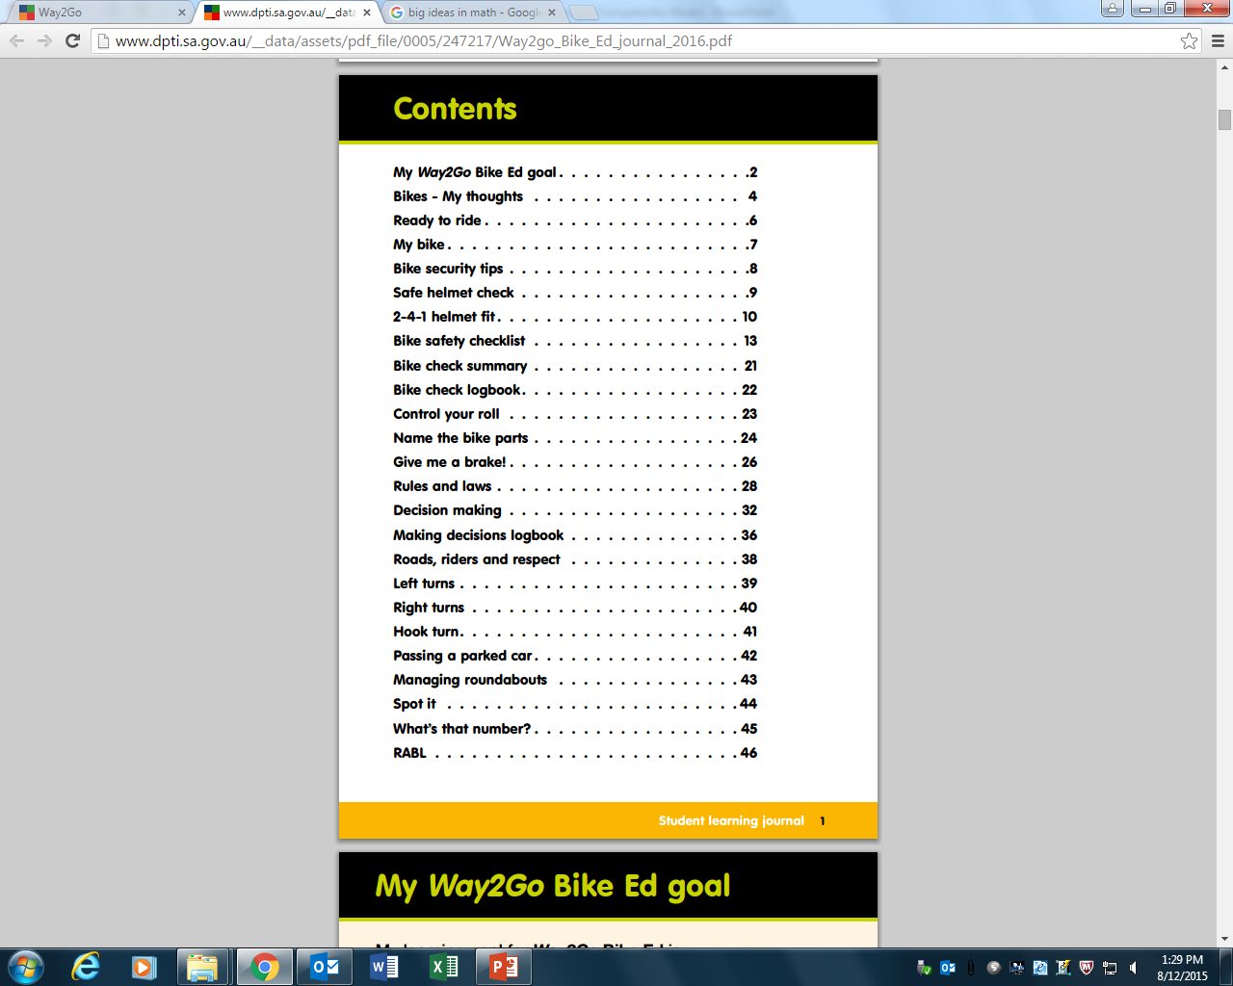

Content overview
Topic 1 & 2
Class teacher must complete the essential lessons prior to the first session with instructors
Topic 3 & 4
Class teacher may complete these lessons during the program to support student achievement
Additional tasks
Class teacher may choose to use in class or as homework
Bike Safety Check & intersection quiz
Negotiate use with service provider
Notes:
Refer to the online teacher resource for more detail about each topic.

Slide 4
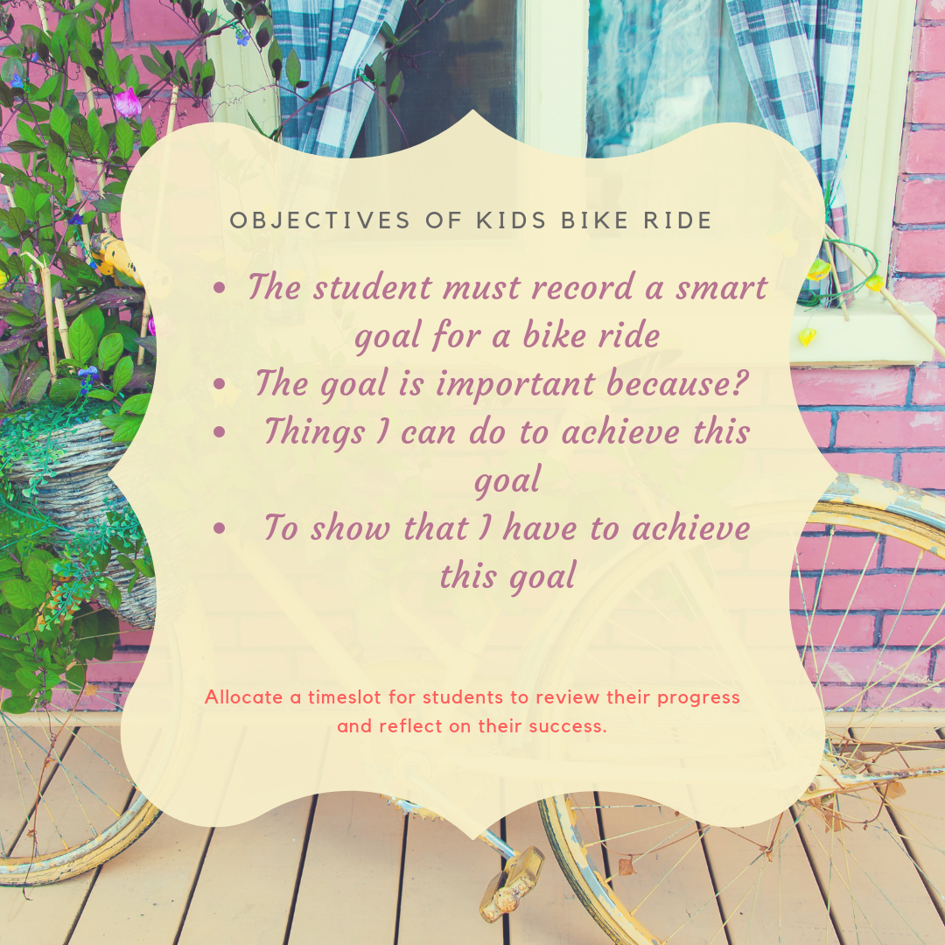

Slide 5
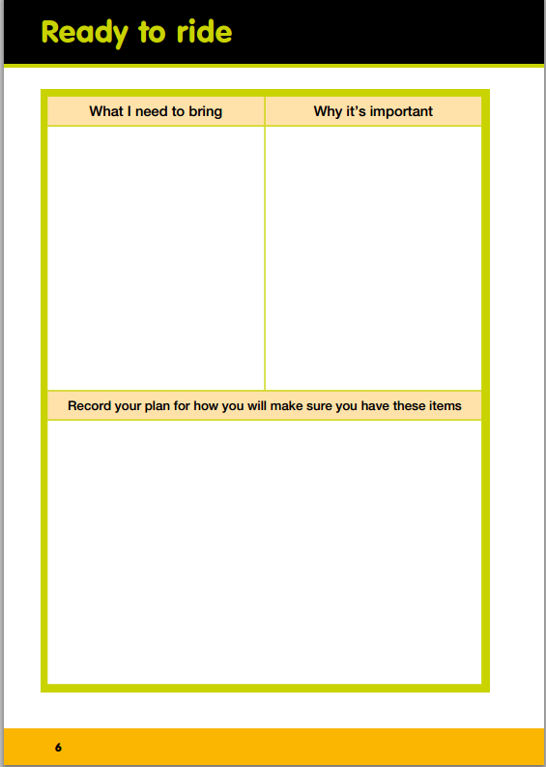
Purpose
Student will know the purpose of wearing protective gears
Example items
Helmet Protects my head if I have an accident
Safe and roadworthy bike To be able to control my bike
Water To stay hydrated
Sneakers, laces tucked in To protect my feet
Sun cream Sun safety - avoid skin burn
Use dot points to record each item
To address H & PE for Yr. 3/4 students must identify and practise strategies that promote their health and safety.
Example
I will clip my helmet to my school bag so I don’t forget to bring it. I will check my bike the night before so it is ready to ride to school in the morning. When I pack my lunch I’ll fill up my water bottle and put my suncream in my bag at the same time. I will wear my sports uniform and sneakers on the day we have Way2Go Bike Ed so I have the right gear to ride.
To address H & PE for Yr. 5/6 students must plan and practise strategies that promote their health and safety.

Slide 6
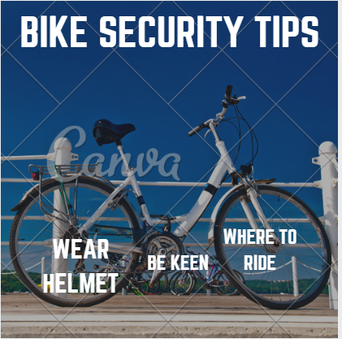

Slide 7
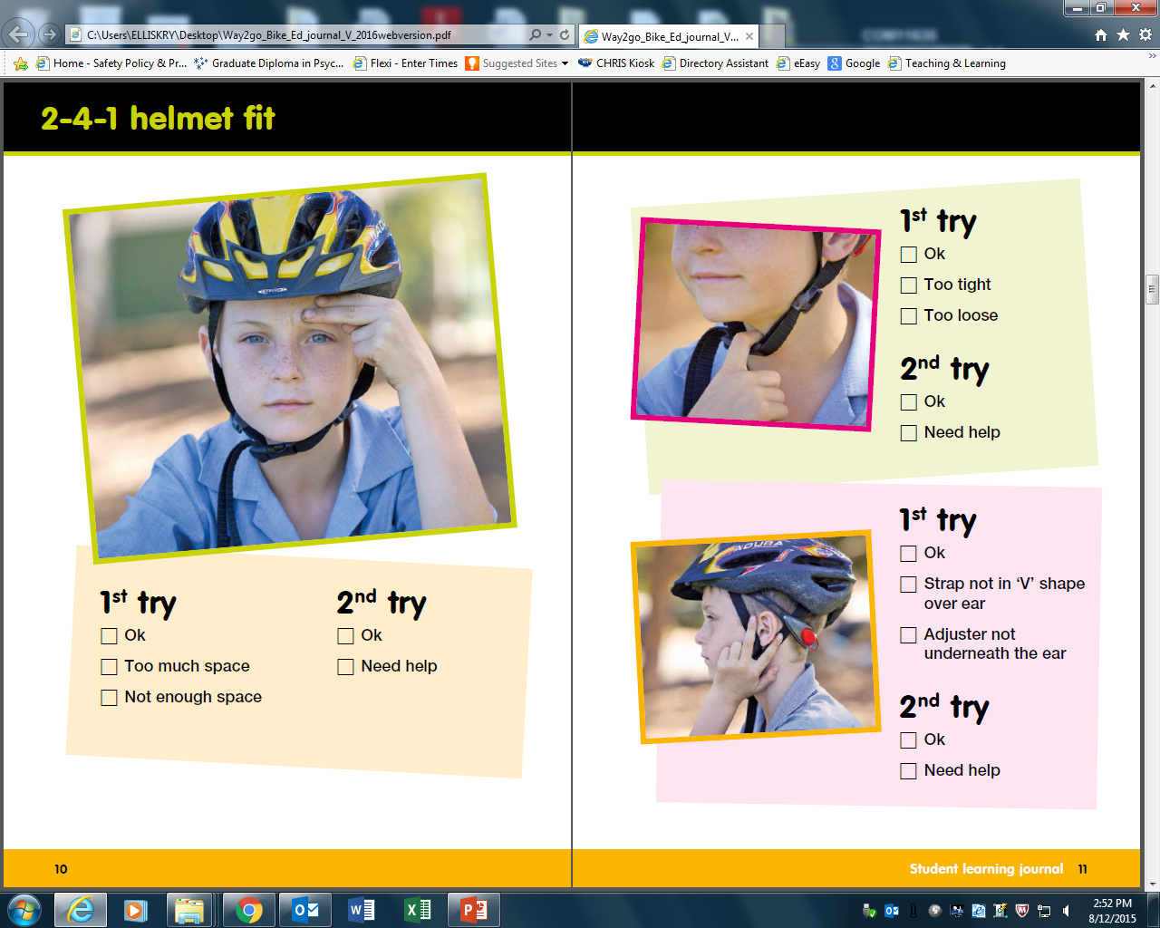
It is important to give every student the opportunity to practise fitting a helmet correctly. If you don’t have enough helmets for each child have them work in small groups using hair nets if there are hygiene concerns.
Make sure that students use the checklist to record their ability to do this task independently.

Slide 8
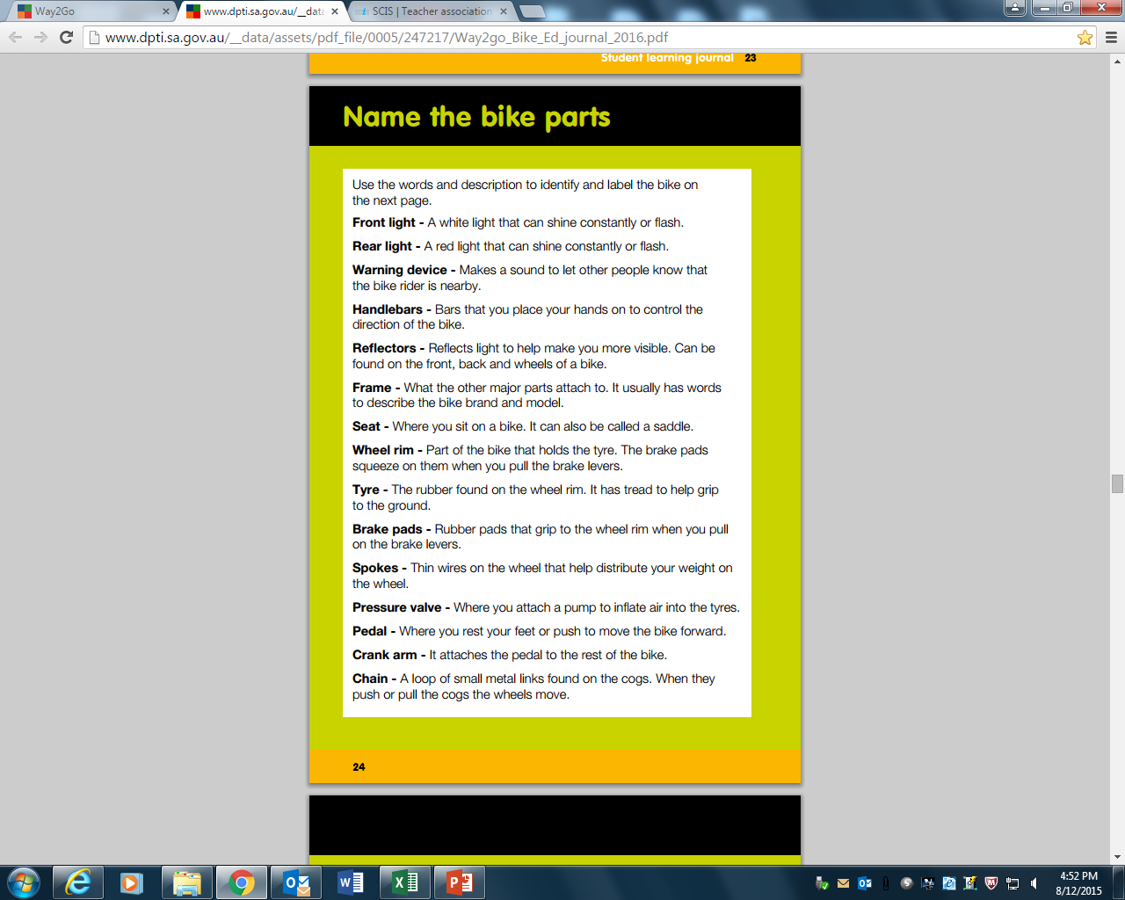
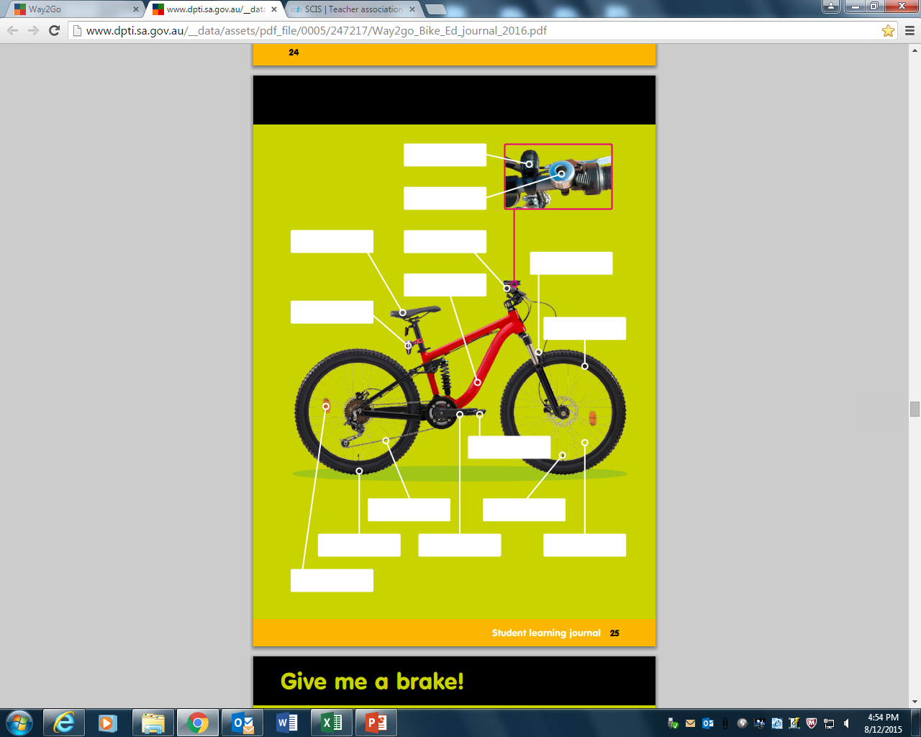
Front light
Warning device
Seat
Handlebars
Brake pads
Frame
Rear light
Wheel rim
Pedal
Chain
Pressure valve
Tyre
Crank arm
Spokes
Reflectors
Notes:
Use this activity to support students to learn the name of bike parts.

Slide 9
The progress quiz

Slide 10
Things to know…
The school program coordinator must be consulted on asking student to do the quiz
When carrying out the quiz instruct students to select the route number not colour on the exam sheet

Slide 11
References
https://www.youtube.com/watch?v=GyLlw1CgXf8
https://www.youtube.com/watch?v=qjxN82kjfr0
https://www.youtube.com/watch?v=imPQ3lysWnU

